Slide 1
Round Robin
Presented by: Phoon Yew Fai 2370265-DCS Danerson Teh Jie Sheng 2370276-DCS Lai Jun Cheng 2370293-DCS Wong Weng Hong 2390009-DCS

Slide 2
Definition of Round Robin

Slide 3
Definition of Round Robin
Round Robin is a CPU scheduling algorithm where each process is cyclically assigned a fixed time slot.
Each process is provided a fix time to execute, it is called a quantum.

Slide 4
Step of Round Robin Scheduling
Ready queue (For those Processes which eligible)
The Ready Queue does not hold processes which:
Already present in the Ready Queue.
non unique processes.
Completed processes
By holding same processes Redundancy of the processes increases
Executing processes
(a time quantum)
Requeue the processes
Not done
done
Remove completed processes

Slide 5
Characteristic of Round Robin

Slide 6
Characteristic of Round Robin
Preemptive algorithm
Shifted to next process after fixed interval time
One of the Oldest, fairest and easiest algorithm
Hybrid model that’s clock-driven
Minimum where it’s assigned for specific task
It will differ between OS to OS
Widely used scheduling method in traditional OS
Notes:
Preemptive algorithm (Preemptive scheduling) is process transitions from running or waiting to ready state Known as mentioned at the definition; Time Quantum or Time Slicing

Slide 7
Pros of Round Robin

Slide 8
Most Efficient algorithm
Pros of Round Robin
Most efficient algorithm
CPU equally allocated to each process
Could be implement in System
Not affected by Convoy effect or starvation

Slide 9
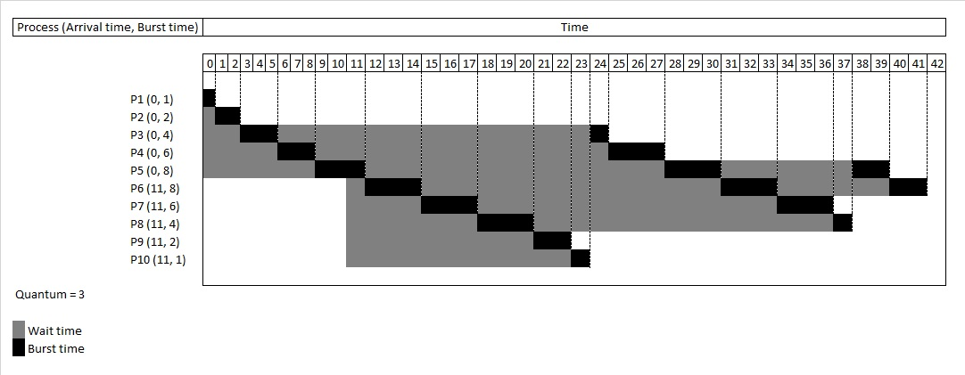
Most Efficient algorithm
Assigned a fixed time slice or quantum
Process not finish,
placed to back and allow next process execute

Slide 10
CPU is equally allocated to each process
every single process had to be done or pause after 3 quantum of time
After all process is involved, it returns to the previous undone process and start executes, until all process are finished

Slide 11
CPU is equally allocated to each process
Each process is assigned with the fixed time,
Ensures not process can monopolize the CPU

Slide 12
It could be implemented in the system
CPU will only run in process burst time
Greatly avoid performance lost and increase processing efficiency

Slide 13
It could be implemented in the system
Not affected by Convoy effect or starvation
Doesn’t rely on the length of time a process needs to complete
This simplicity makes it easy to implement and manage

Slide 14
Not affected by Convoy effect or starvation
Convoy = short process get stuck behind a long process
Starvation = process never give CPU time due to scheduling algorithm priorities

Slide 15
Equal time slices
Cyclic order

Slide 16
Disavantage of round robin

Slide 17
High priority tasks may no complete in the first time
Round robin process the task not using priority, what task come the first the task process, just like ascending. However procedures cannot have priorities established. So it cause the high priority tasks can’t been complete in the first time.

Slide 18
Long task may increase the respond time
Every task have their limited time to process their task. When the time ends the task will stop and the other task will start to process, no matter the task finish or not.
This will cause long task will always been stop and will have a long responding time.

Slide 19
Will cause no responding
The task is been separate to many piece and give it to the cpu. This cause the cpu all cores functioning. This will cause the cpu using large resource of the computer like memory and others. This may cause the computer lag and not responding.

